Slide 1
Robotics Group Project
Bayesian Localisation and A* Search
Jamie Slome
Jack Galvin
Zehra Punjwani

Slide 2
Hardware Design

Slide 3
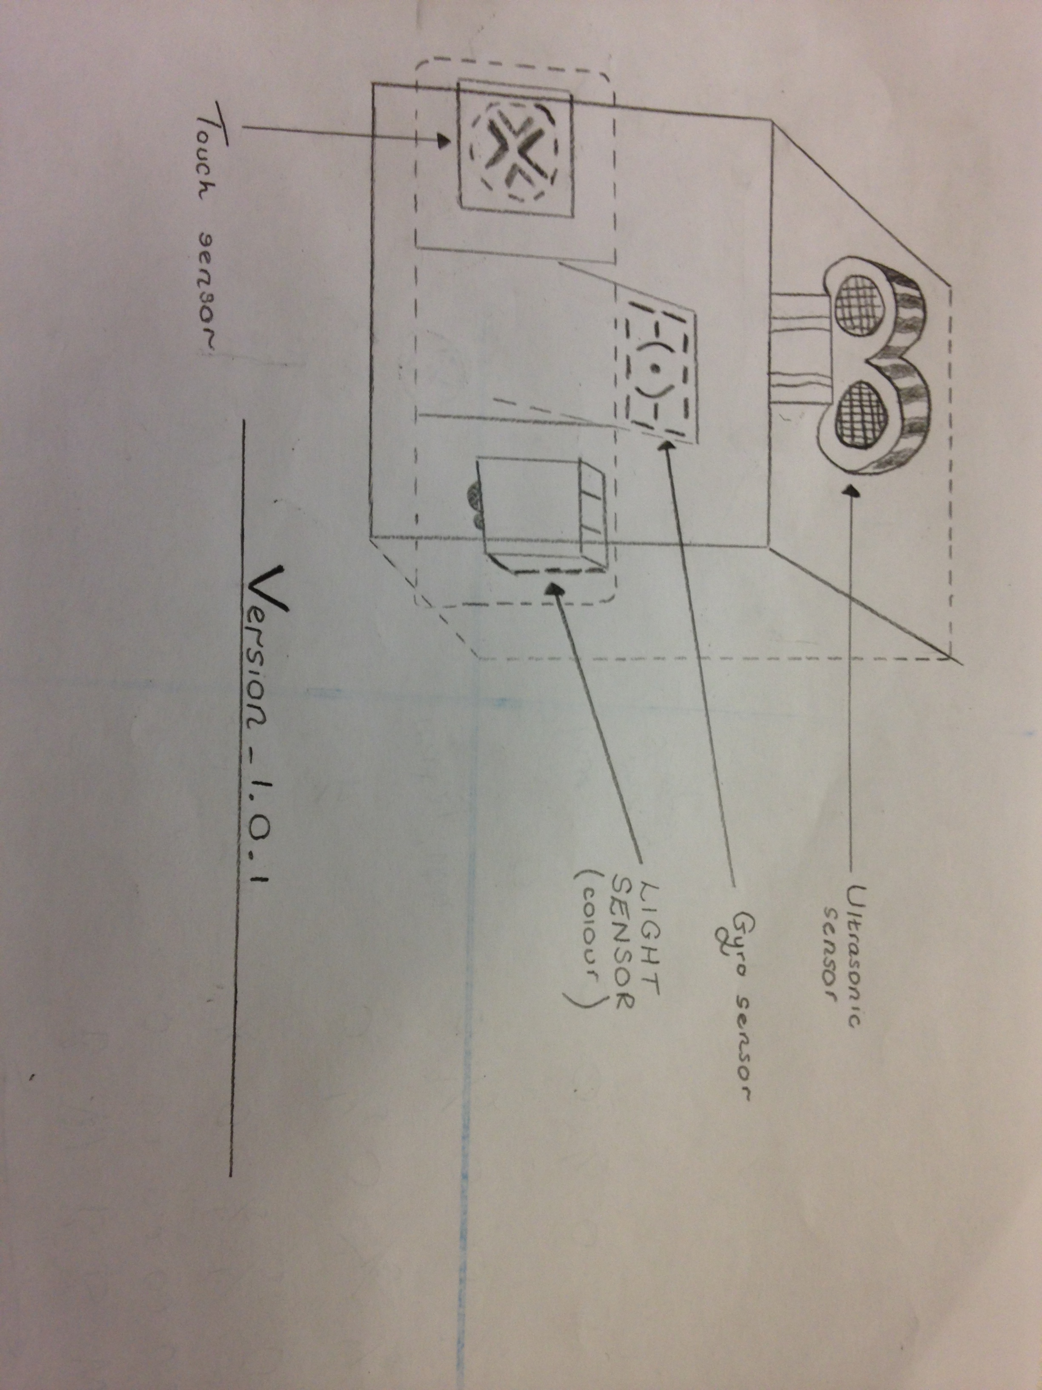
BLU_Print_1.0.0
Ultrasound sensor
Gyroscope sensor
Light sensor
Touch sensor

Slide 4
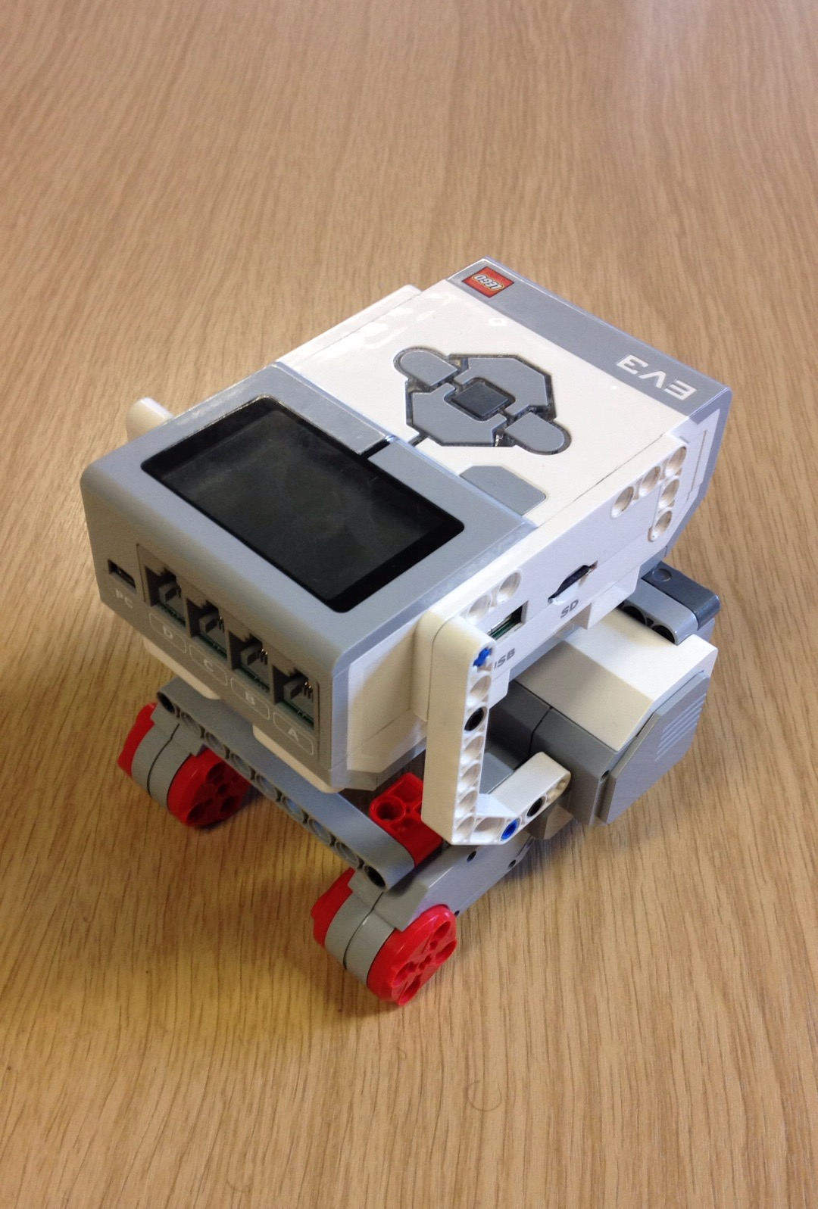
EV3_Vers_1.0.0

Slide 5
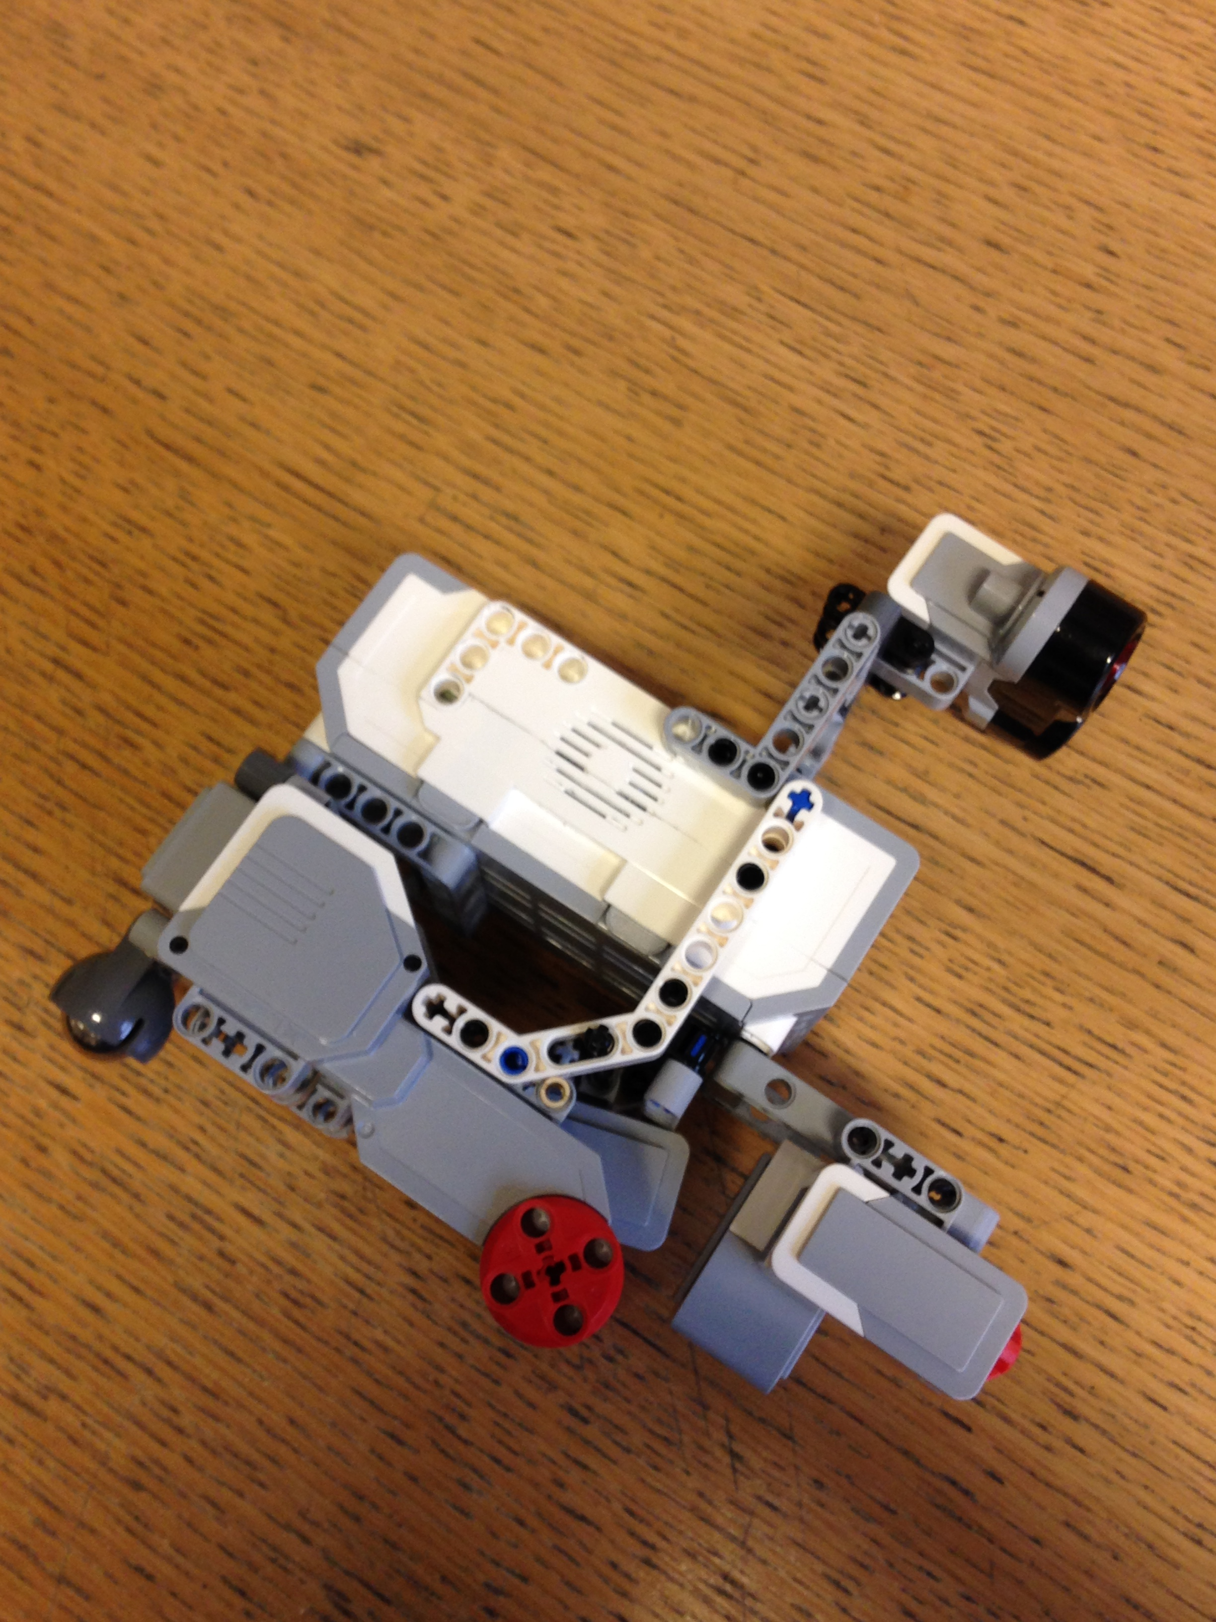
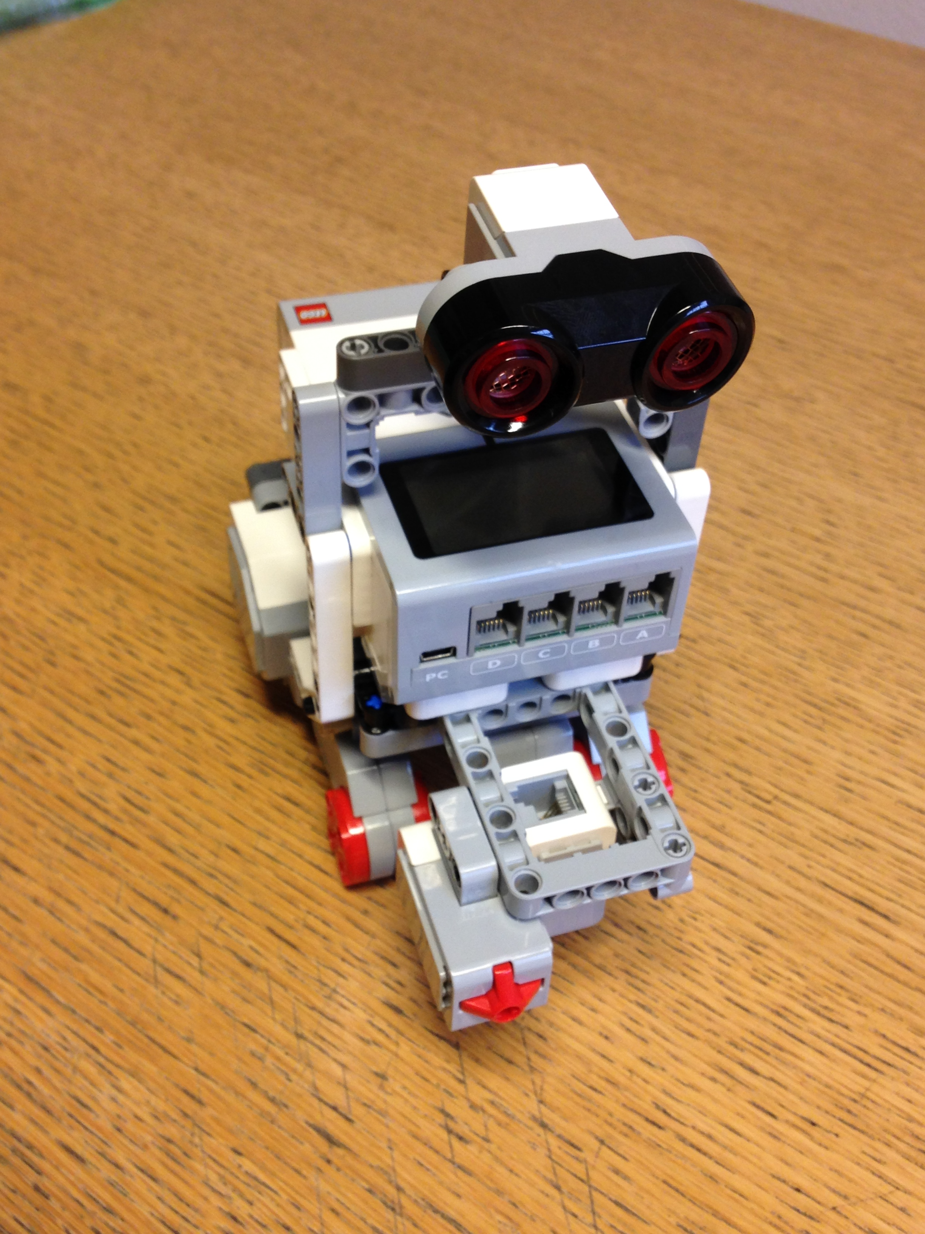
EV3_Vers_1.0.1

Slide 6
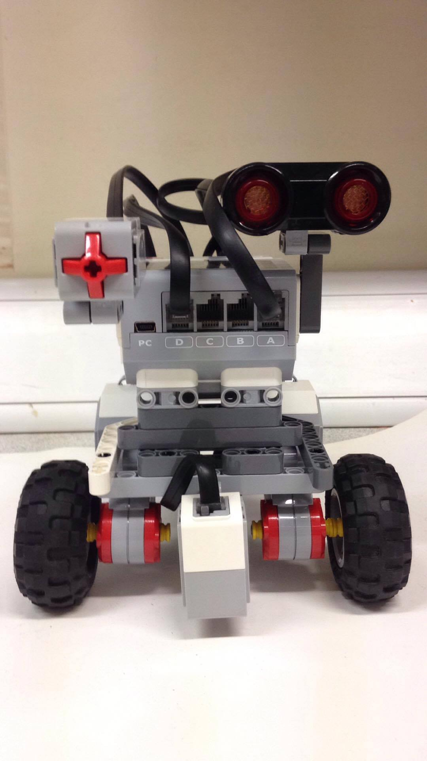
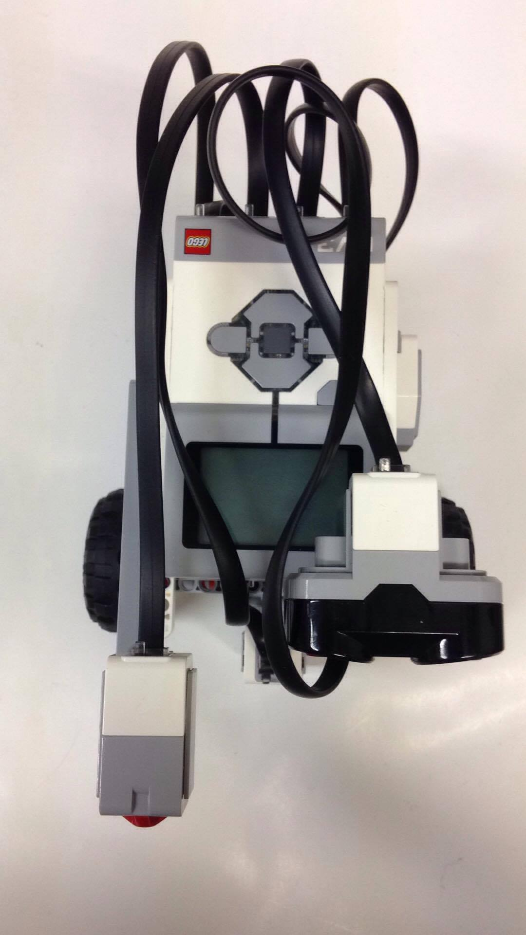
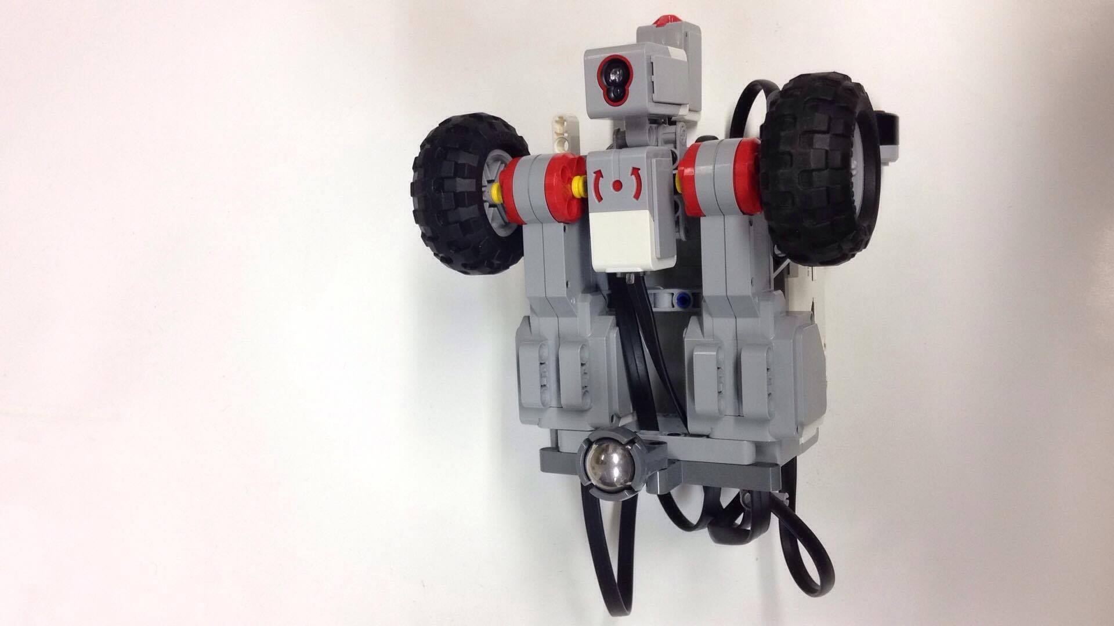
EV3_Vers_1.1.0

Slide 7
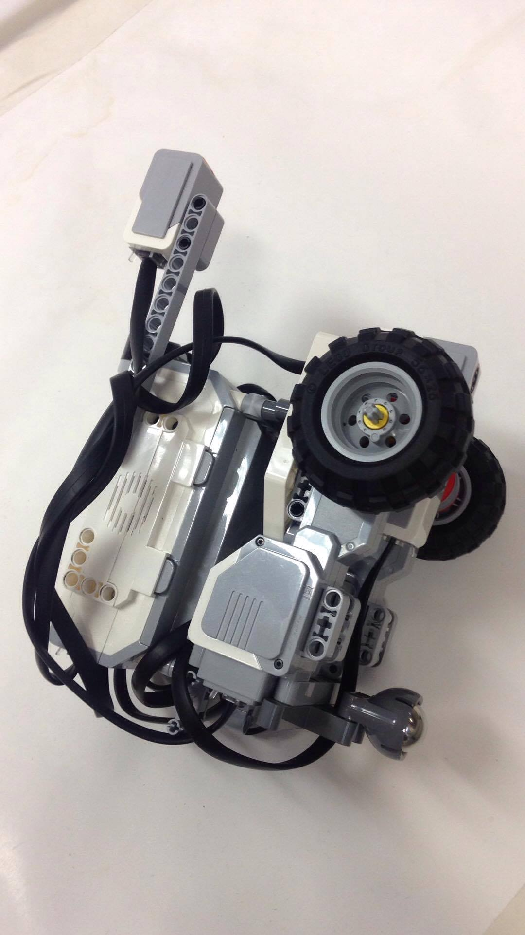
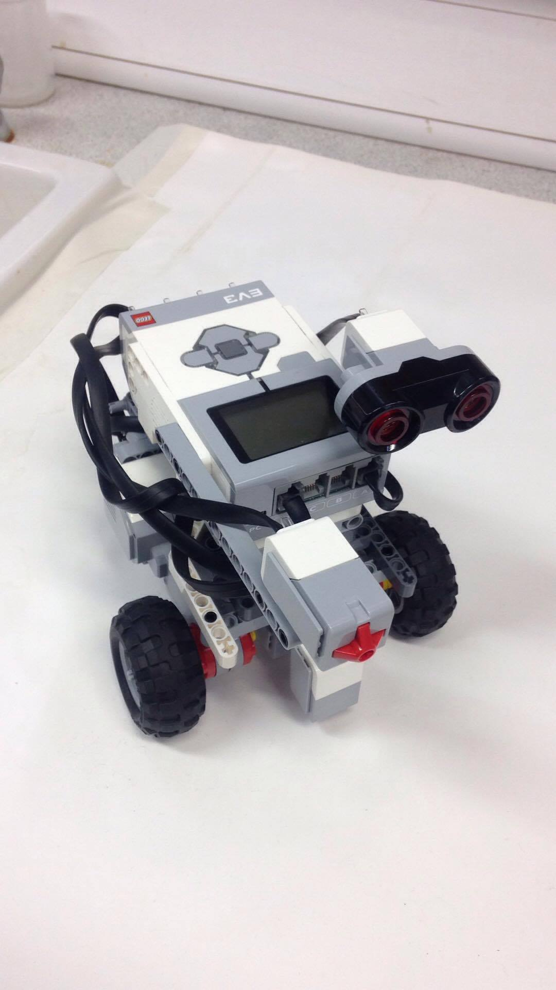
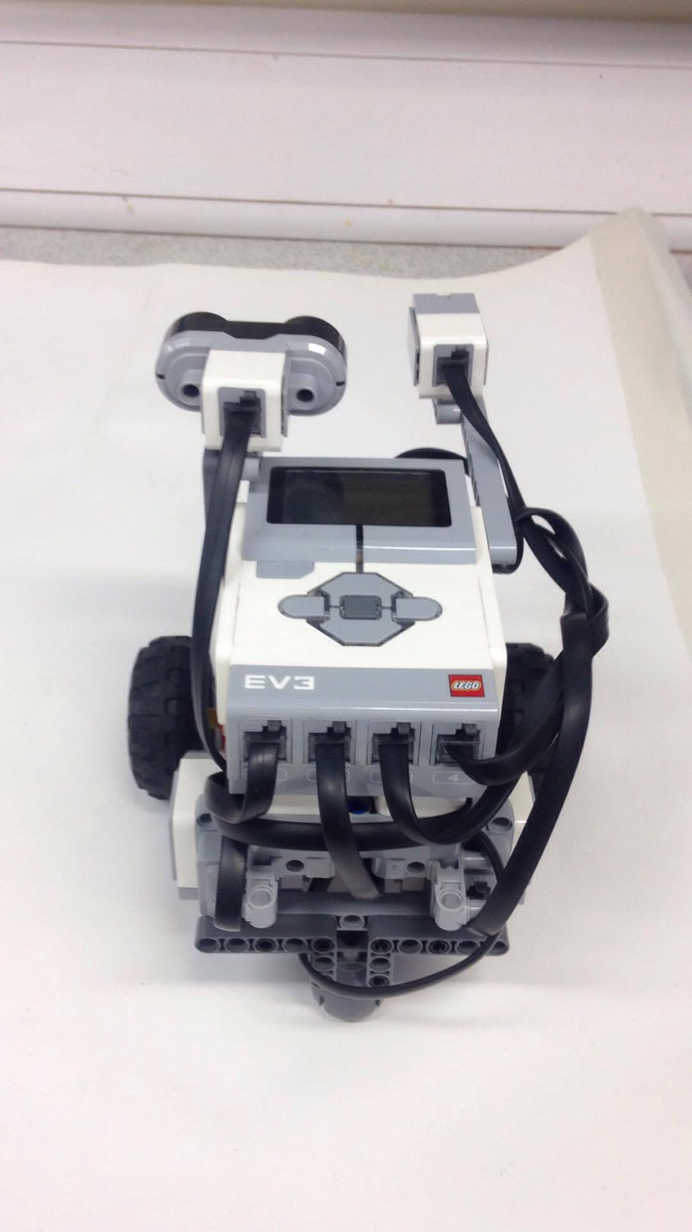
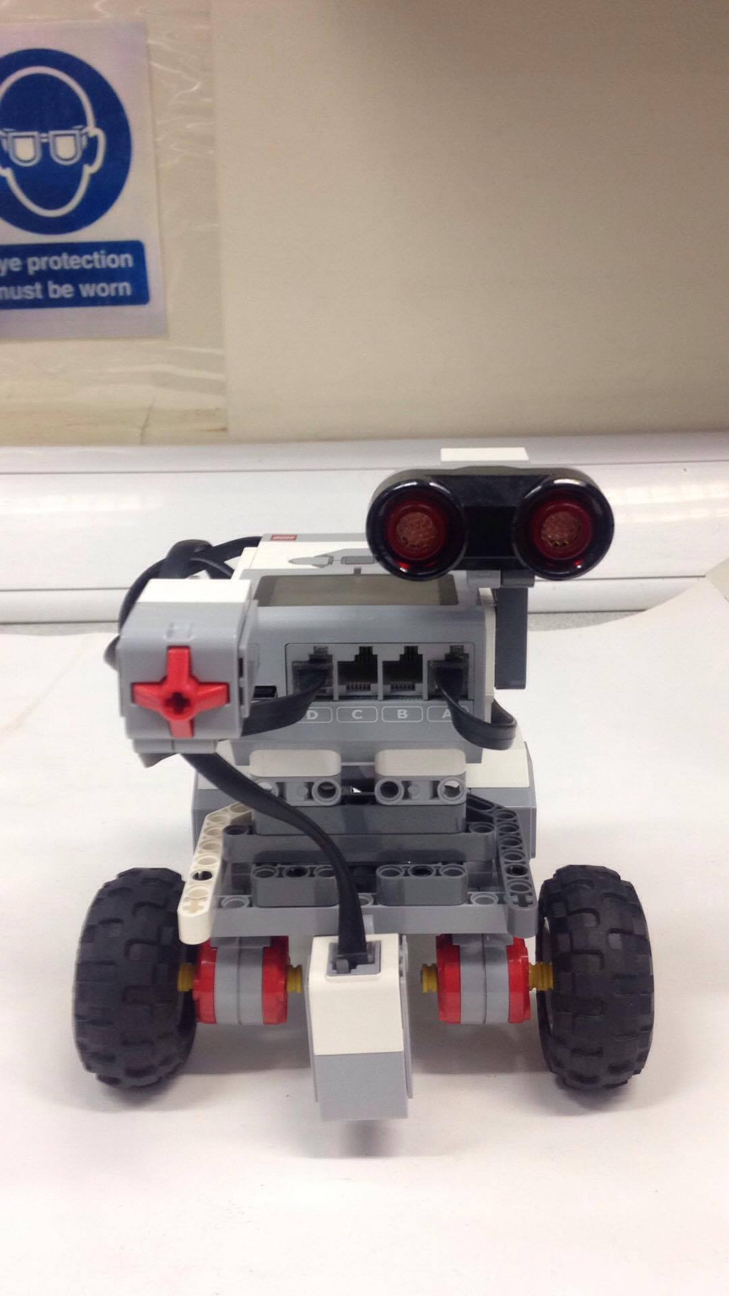
EV3_Vers_1.1.1

Slide 8
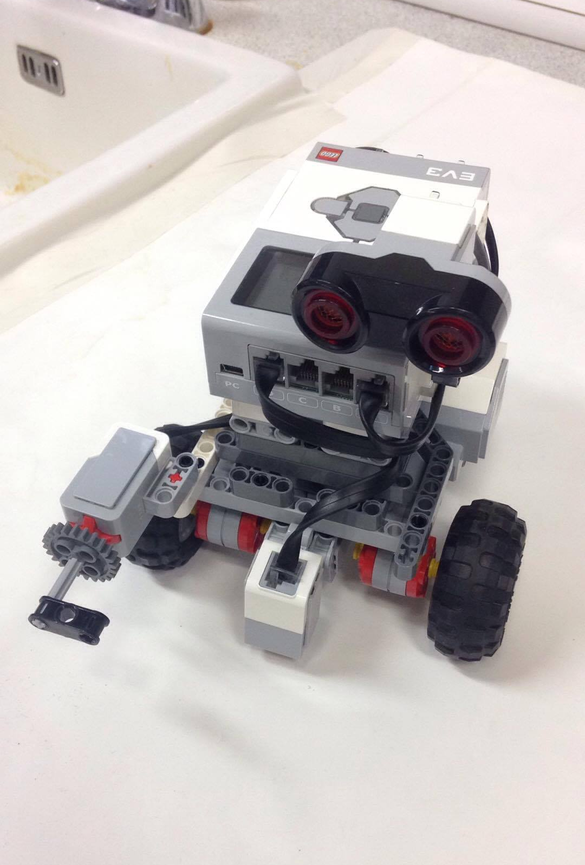
EV3_Vers_1.2.0

Slide 9
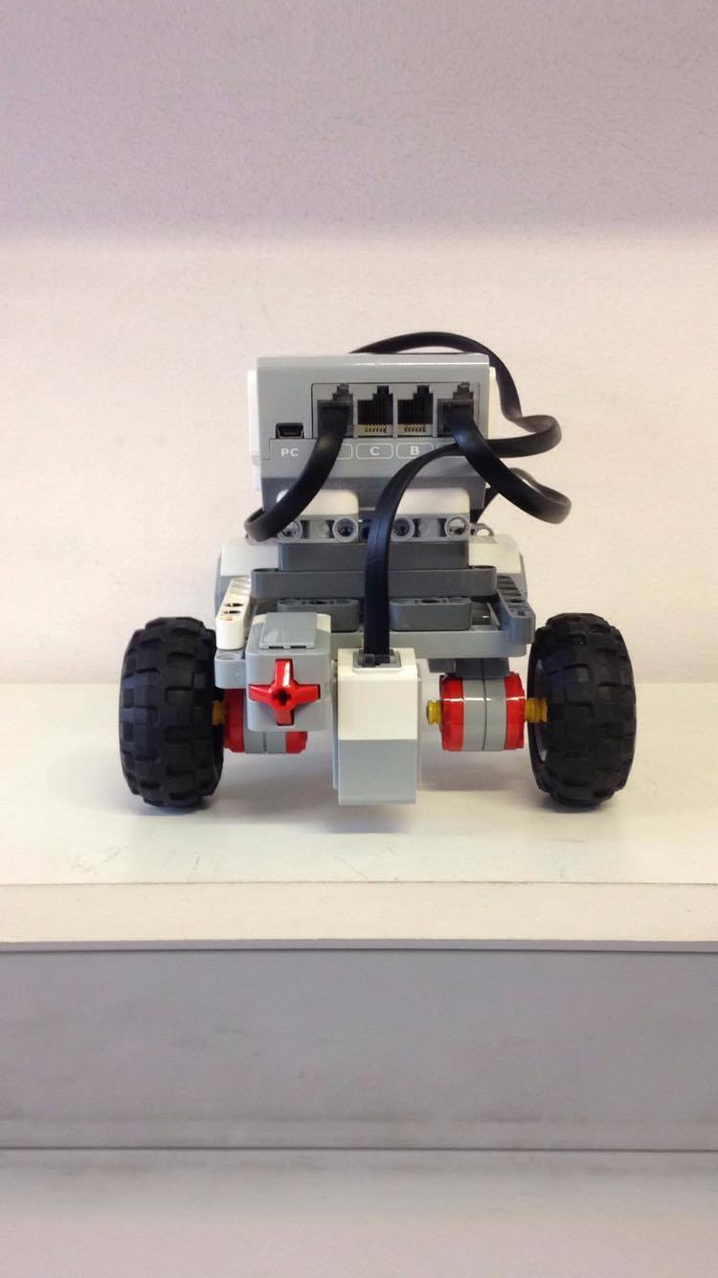
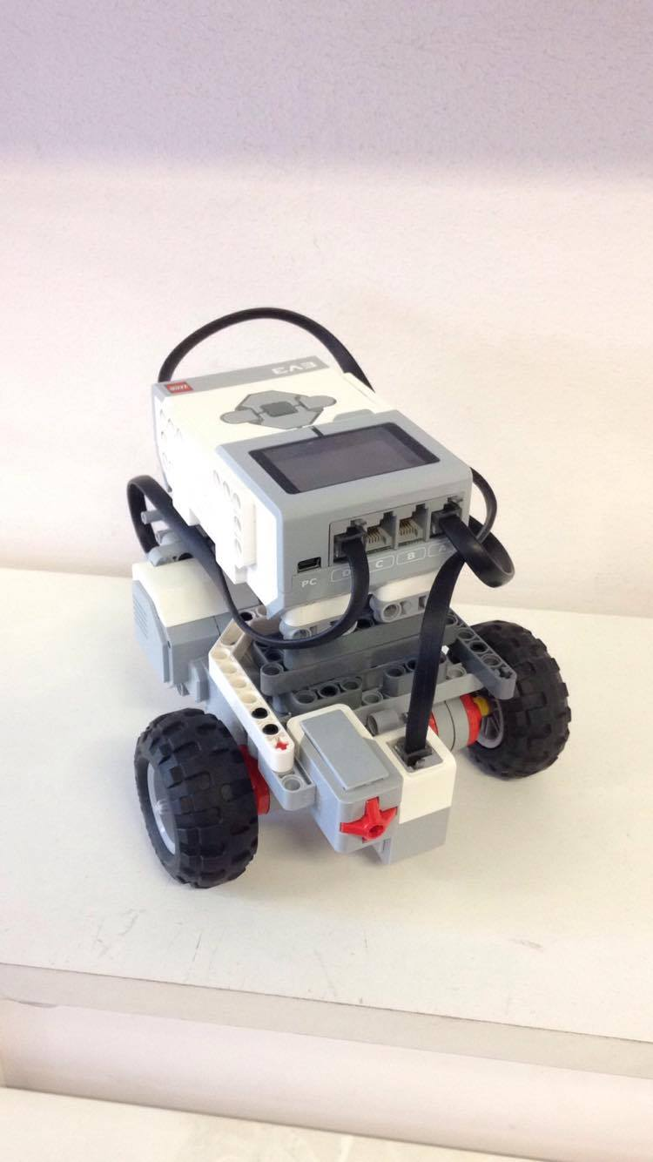
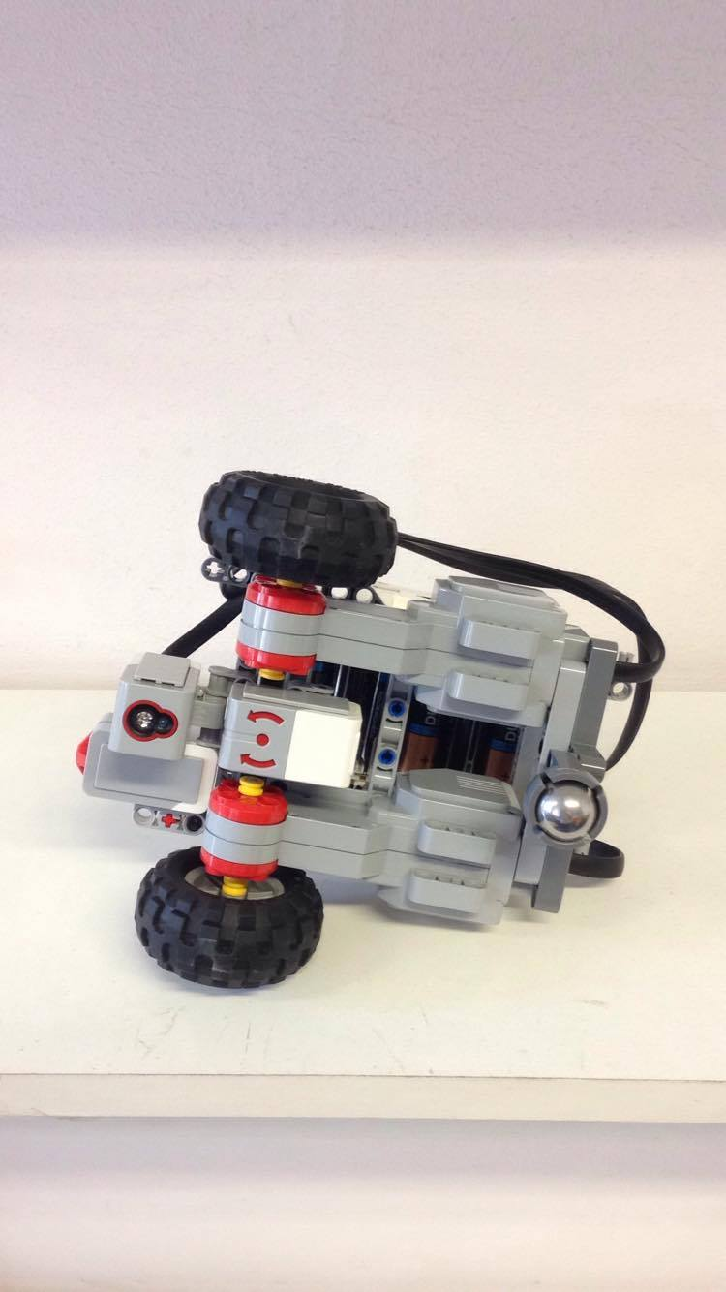
EV3_Vers_1.3.0

Slide 10
Software Design

Slide 11
Bayesian Localisation Pseudo Code
declare lightValue;
declare totalProbability;
declare and initialise arrayOfProb;
for(item in arrayOfProb) {
each item in arrayOfProb -> 1/size of arrayOfProb;
}
while(true) {
lightValue -> reading from sensor;
/*UPDATE*/
for(item in arrayOfProb) {
if(lightValue == arrayOfProb at index item) {
item in arrayOfProb = probSensorWorks * item in arrayProb;
}
else {
item in arrayOfProb = 1-probSensorWorks * item in arrayOfProb;
}
}

Slide 12
Bayesian Localisation Pseudo Code Continued
/*SUM*/
totalProb -> 0;
for(item in arrayOfProb) {
add to totalProbability by each value at index item in arrayOfProb;
}
/*NORMALISE*/
for(item in arrayOfProb) {
item in arrayOfProb = item in arrayOfProb/totalProbability;
}
moveForward(given distance);
/*UPDATE*/
for(index, decrement from back of arrayOfProb) {
if(index == 0) {
index of arrayOfProb= index of arrayOfProb * (1-probMotorWorks);
}
else {
index of arrayOfProb = index of arrayOfProb * (1-probMotorWorks) + index -1 of arrayOfProb* probMotorWorks;
}
}
/*SUM*/
totalProbability -> sum the total probabilities;

Slide 13
Bayesian Localisation Pseudo Code Continued
/*NORMALISE*/
divide every item in arrayOfProb by totalProbability;
maxValue -> 0;
maxInd -> 0;
for(each item in arrayOfProb) {
if(item > maxValue) {
maxValue -> item;
maxInd -> index of item;
}
}
if(maxValue > 0.75) {
stop motors;
return maxInd*2.0;
}
}
}

Slide 14
A* Search Pseudo Code
initialise openList
initialise closedList
add startNode to openList -> f.Set(0)
while(openList !empty) {
node.lowestF-> q
q.remove -> openList
generateNeighbours of q, setParents -> q
for(each neighbour) {
if(neighbour == goal) {
return finished;
}
set g,h,f of neighbour
if(neighbour in openList with lower f) {
skip node;
}
if(neighbour in closedList with lower f) {
skip node;
}
else {
add neighbour -> openList;
}
}
q -> closedList;
}

Slide 15
Movement Translation Pseudo Code
while(current.hasNext) {
for(node in list) {
if((node + 1).xPos - (current.xPos) == 1 ) {
rotateRight(90);
north -> oldEast;
east -> oldSouth;
south -> oldWest;
west -> oldNorth;
moveForward(2);
}
else if((node+1).xPos - current.xPos == -1) {
rotateLeft(90);
north -> oldWest;
east -> oldNorth;
south ->oldEast;
west -> oldSouth;
moveForward(2);
}
else if((node+1).yPos - current.yPos == 1) {
moveForward(2);
}
else if((node+1).yPos - current.yPos == -1) {
moveBackward(2);
}
}
}

Slide 16
Evaluation of Hardware and Software Design

Slide 17
Hardware
Purpose-built
Distribution of weight
Cable management
Size of footprint – smaller?

Slide 18
Software
Modularity
Commenting
Duplicated values?
Versioning standards?

Slide 19
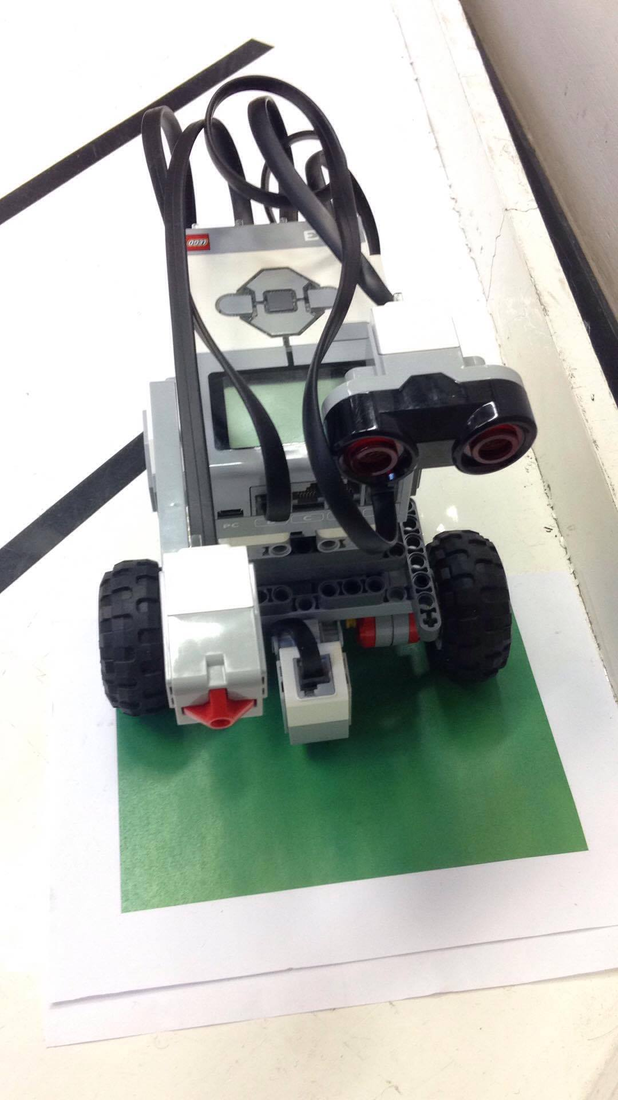
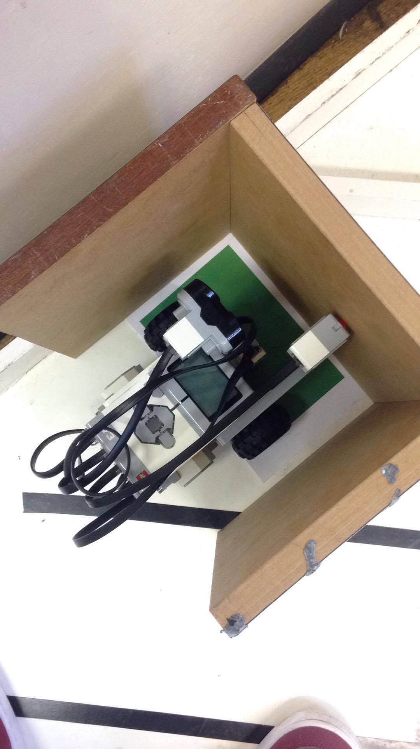
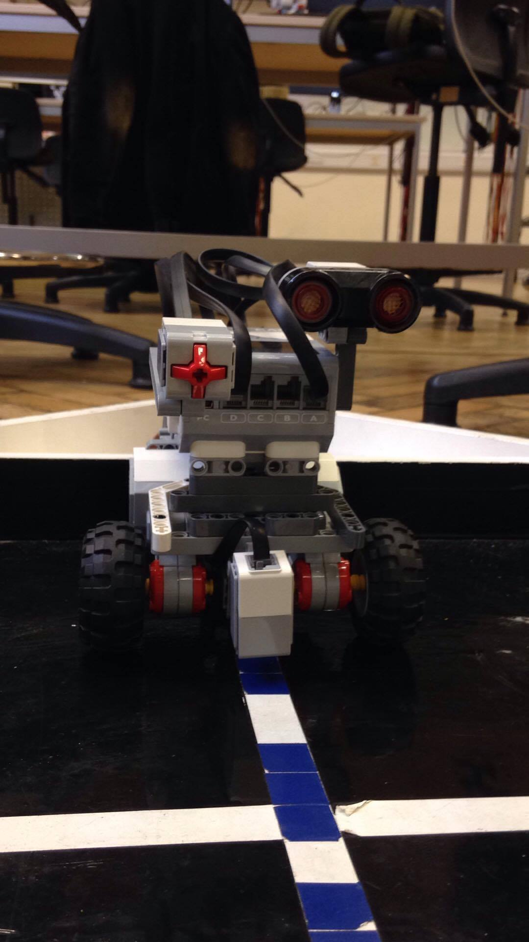
Integrated System Testing

Slide 20
Integration System Testing
Bayesian Filter
A* Search
Colour Co-ordinated Path Plan
Successful Iteration of Task 1-4

Slide 21
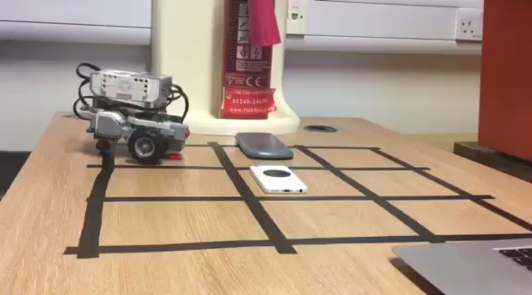

Slide 22
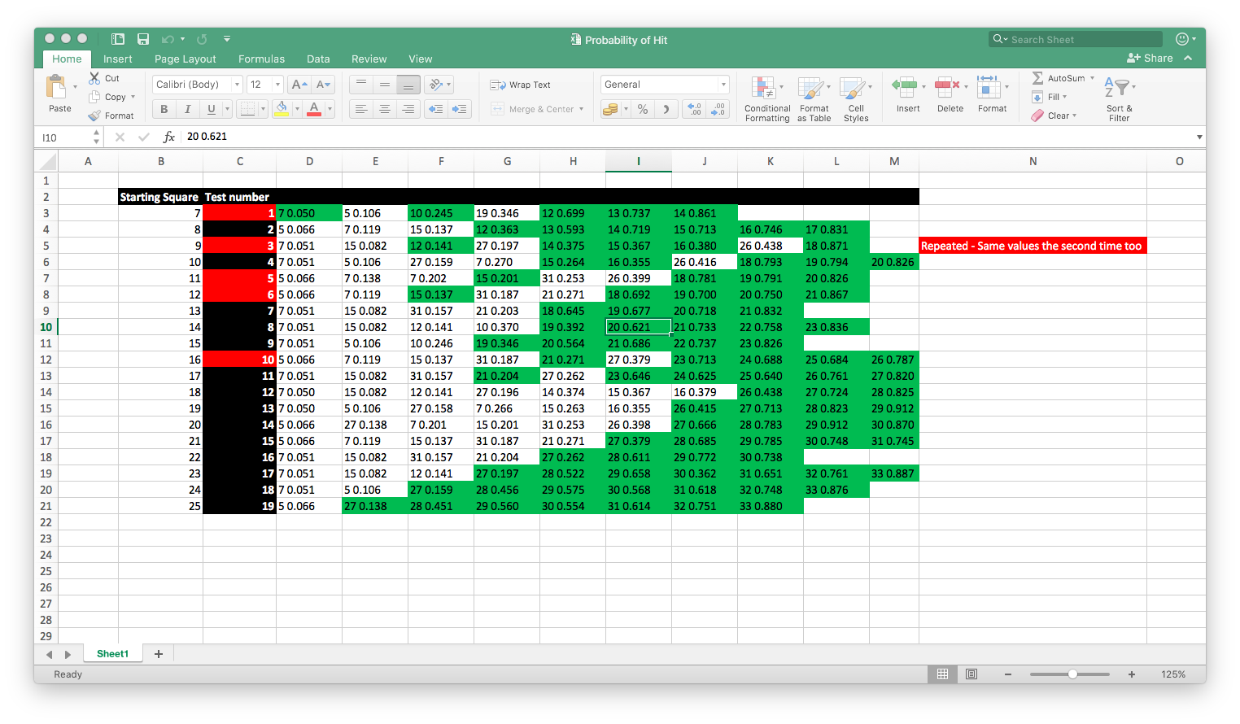
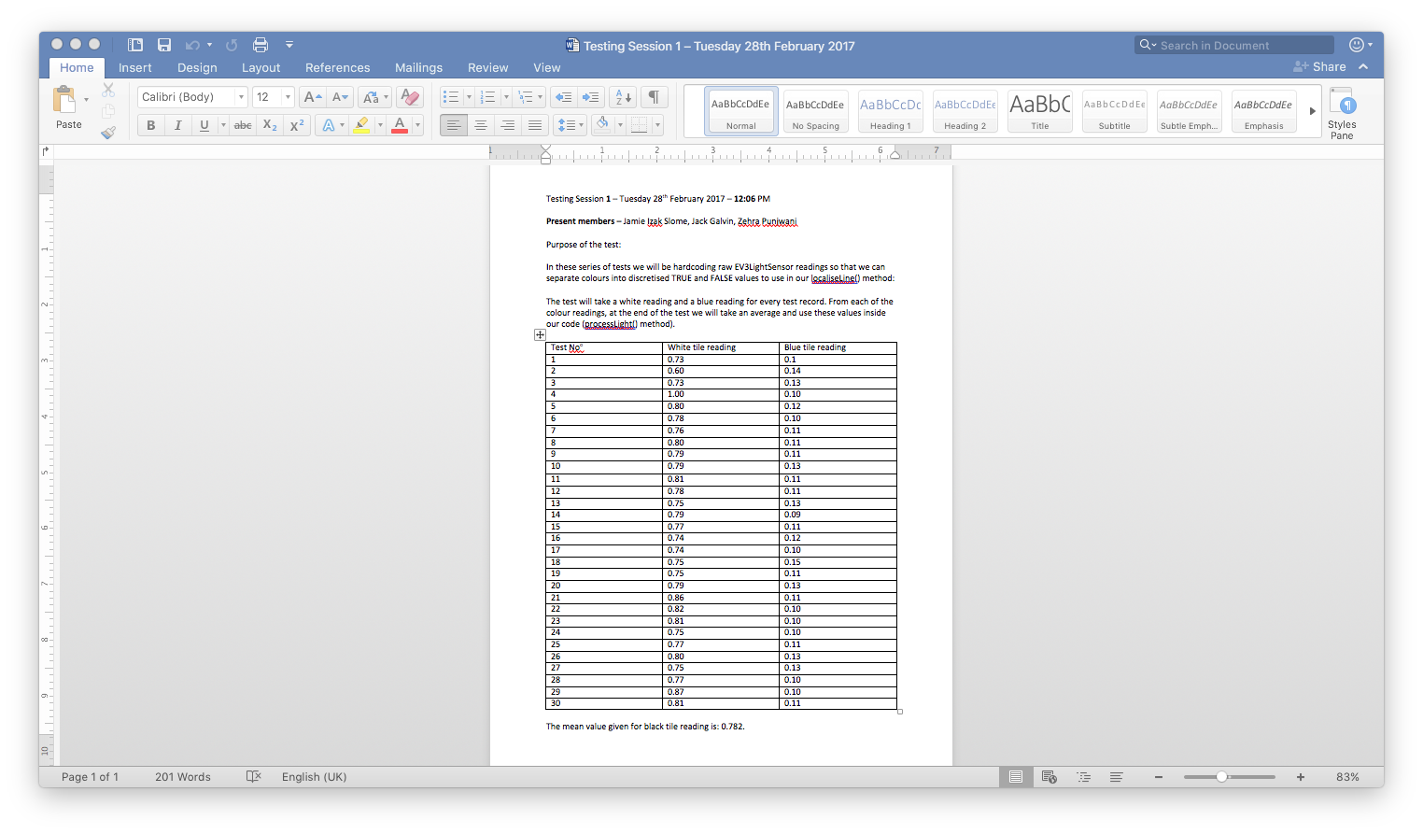
Single Function Testing

Slide 23
Single Function Testing
Black-Box Testing
Testing for an appropriate light discretisation value.
Testing for an appropriate threshold value to break the Bayesian filter method.
Reliability and Performance testing for entire system.

Slide 24
Team Management

Slide 25
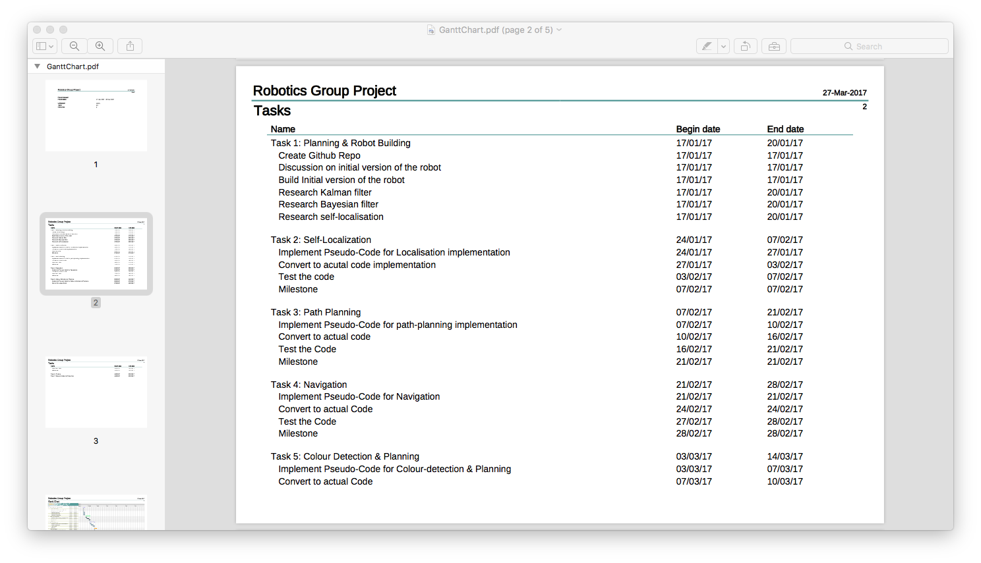
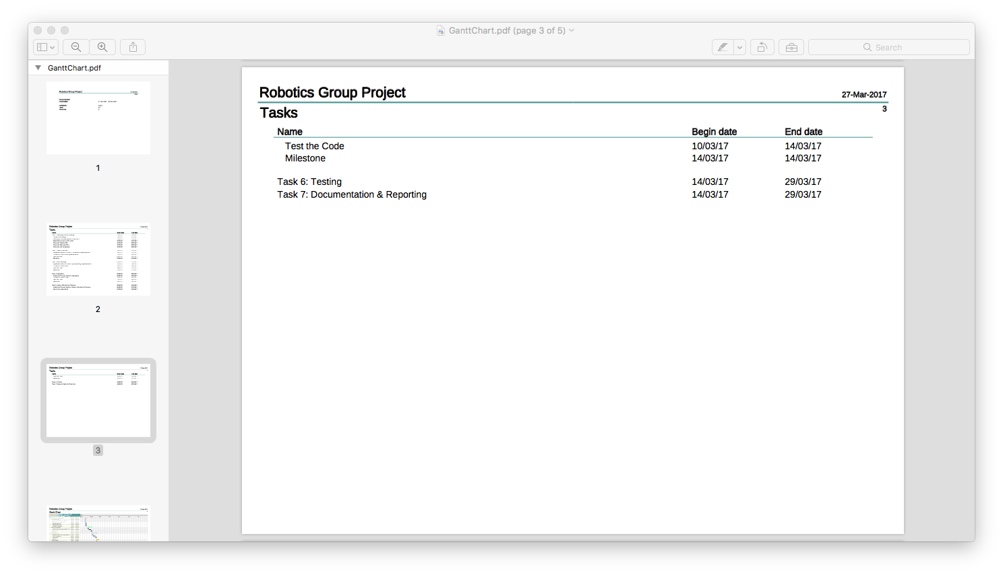
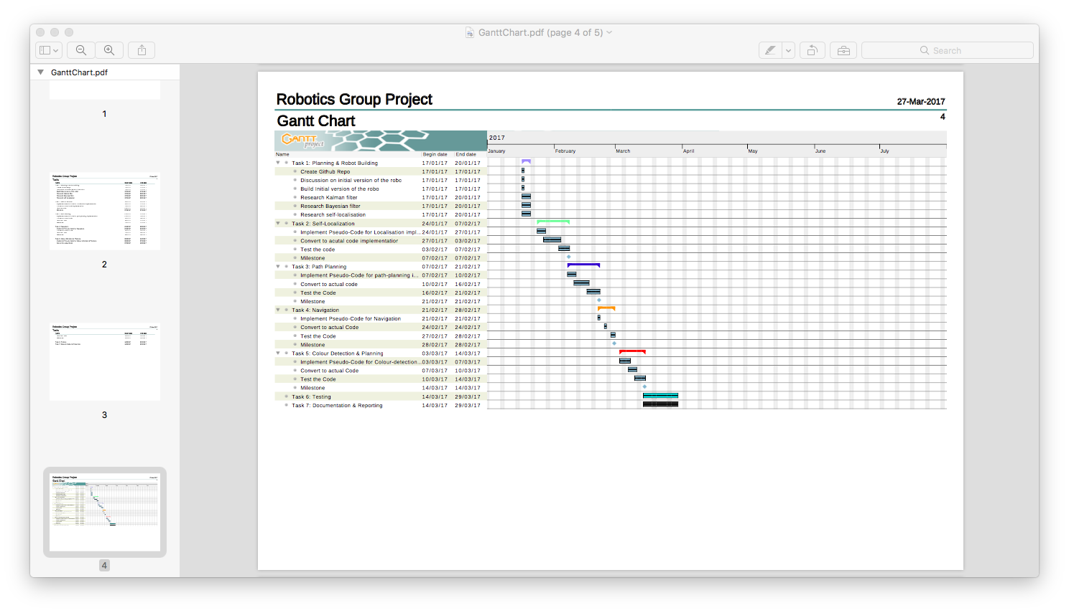
Milestones and Main Tasks

Slide 29
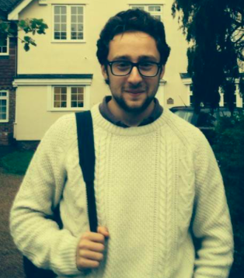
Jamie Slome
Hardware: designed initial build configuration and appropriately versioned hardware additions.
Software: designed and implemented smaller methods used to handle sensor data and revised Bayesian method.
Testing: black-box testing for Bayesian filter, testing all possible probabilities.

Slide 30
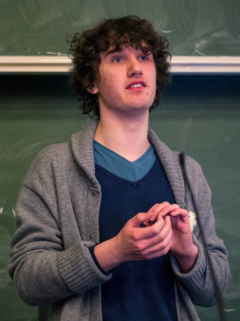
Jack Galvin
Hardware: assisted in the initial build of the robot and engineered updated builds to suit the changing requirements.
Software: Implemented A* Search and initial Bayesian method.
Testing: Present and involved with light sensor readings and path planning tests.

Slide 31
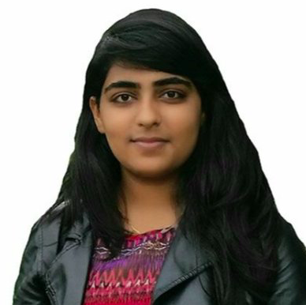
Zehra Punjwani
Hardware: structurally engineered the robot and made symmetric frame to work upon. Cable management also covered.
Software: helped with implementation of Bayesian filter, pseudo code and diagrammatic break down.
Testing: outlined testing environment for Bayesian filter and captured values correctly.

Slide 32
Conclusion and Comments

Slide 33
Task 1:
Task 2:
Task 3:
Task 4:
Localise robot with respect to a known line.
Apply Bayesian localisation to accurately determine the robot location.
Plan path from robot location to the goal.
Find the shortest path to goal.
Reach the goal location.
Rotate towards the narrow path.
Move towards the end and read colour.
Signal arrival by using touch sensor then play beep.
Manoeuvre out of the obstacle.
Based on colour of pad, position of obstacle is known.
Plan a route back to starting point using this knowledge.

Slide 34
We could have looked into other path planning methods such as potential field.
We could have assigned members smaller tasks and thus improved the rigidity of the implementation.
We could have improved the efficiency of the code by refactoring and removing duplications.
We could have looked into the use of alternative hardware i.e. Arduino, servo-motors, reliable sensors.
We could have tested the software and hardware more intensely to prevent errors and issues occurring during the implementation stage.
This could have included: regression testing (patches) and recovery
testing (system failures).

